Slide 1
What counts as disability? Who decides? A socio-cultural examination of disabled students’ experiences at South African universities
Human development and capabilities association-health & disability thematic group 04 February 2015
Oliver Mutanga (PhD Fellow)-Centre for Research on Higher Education and Development University of the Free State
(Visiting Scholar-Pavia University, Italy)

Slide 2
Outline of the presentation
Background to this paper
Rationale
Main argument
Methodology
Findings
Discussion
Conclusion

Slide 3
BACKGROUND TO THIS PAPER
Contested nature of disability as a concept
  the right wording?--‘with disabilities’ or ‘disabled’
  over-medicalisation, social model(s), ICF and then the CA
What do disabled people say?-The missing link
Reflexive approach cognitive interviewing
Why are disabled students disadvantaged in a transformed HE that is supposed to be fair and equitable?
How can we advance a social justice agenda in HE for disabled students?

Slide 4
Rationale
In addressing social justice issues, we need to be clear about who needs what, at which point in time for achieving what one values

Slide 5
Main argument
For concrete programmes to be implemented, proper policies which state action plans (stakeholders) need to be put in place
Using empirical data of ten students on the experiences and perceptions about disability
The current thinking/ conceptualisation of disability in South Africa is floats all over
This creates problems for disabled students who ultimately places them at a disadvantage
An (expansive) interactionalist approach which acknowledges the complexities is suggested (Tom Shakespeare)

Slide 6
Design & Methodology
Qualitative Design
Semi structured in-depth interviews
Field observations
Institutional document analysis
2 universities
14 disabled students -3 Disability unit staff members- 4 lecturers
Thematic analysis-Nvivo 10 software

Slide 7
Profile of the students
Name | Institution | Category | Age | Faculty | Gender | Race
Kudzi | UniVen | Partially sighted | 39 | Education | Female | Black
Pat | UniVen | Other | 30 | Human and Social Sciences | Female | Black
Musa | UniVen | Physical disability | 29 | Law | Male | Black
Sipho | UniVen | Partially sighted | 21 | Human and Social Sciences | Male | Black
Mpho | UniVen | Physical disability | 22 | Law | Male | Black
Toni | UniVen | Blind | 28 | Human and Social Sciences | Male | Black
Carla | UFS | Learning disability | 22 | Economic and Management Sciences | Female | Coloured
Lerato | UFS | Physical disability | 25 | Law | Female | Black
Anna | UFS | Physical disability | 25 | Law | Female | Black
Joe | UFS | Blind | 20 | The Humanities | Male | White
Dudu | UFS | Hearing | 38 | The Humanities | Male | Black
Michael | UFS | Physical disability | 24 | Education | Male | Black

Slide 8
FINDINGS
South African written policies (good on paper? and too abstract) South African Constitution, Social Model
  1996 (NCSNET, NCESS), 1997 INDS, Education White Paper 3, Higher Education Act
  2001 National Plan for Higher Education, Education White Paper 6
  2012 Green Paper
  2013 White Paper
Institutional level
The University aligns itself with the position adopted by the Disabled People of South Africa (DPSA), which states that it is primarily the society that disables people. Consequently the University’s definition of disability aligns with the one in the Code of Good Practice which focuses on the effect of a disability on (in the University’s context) the student in relation to the study environment, and not on the diagnosis of the impairment. (UniVen)
  Social model
  ‘With disabilities’ v ‘Disabled’……impairment??
  Attitude v Physical access
Participants/ Disabled Students
  *I am not disabled, *I am disabled, *I am better than my peers, *Disability is not abnormality, *I am different and all human beings are disabled

Slide 9
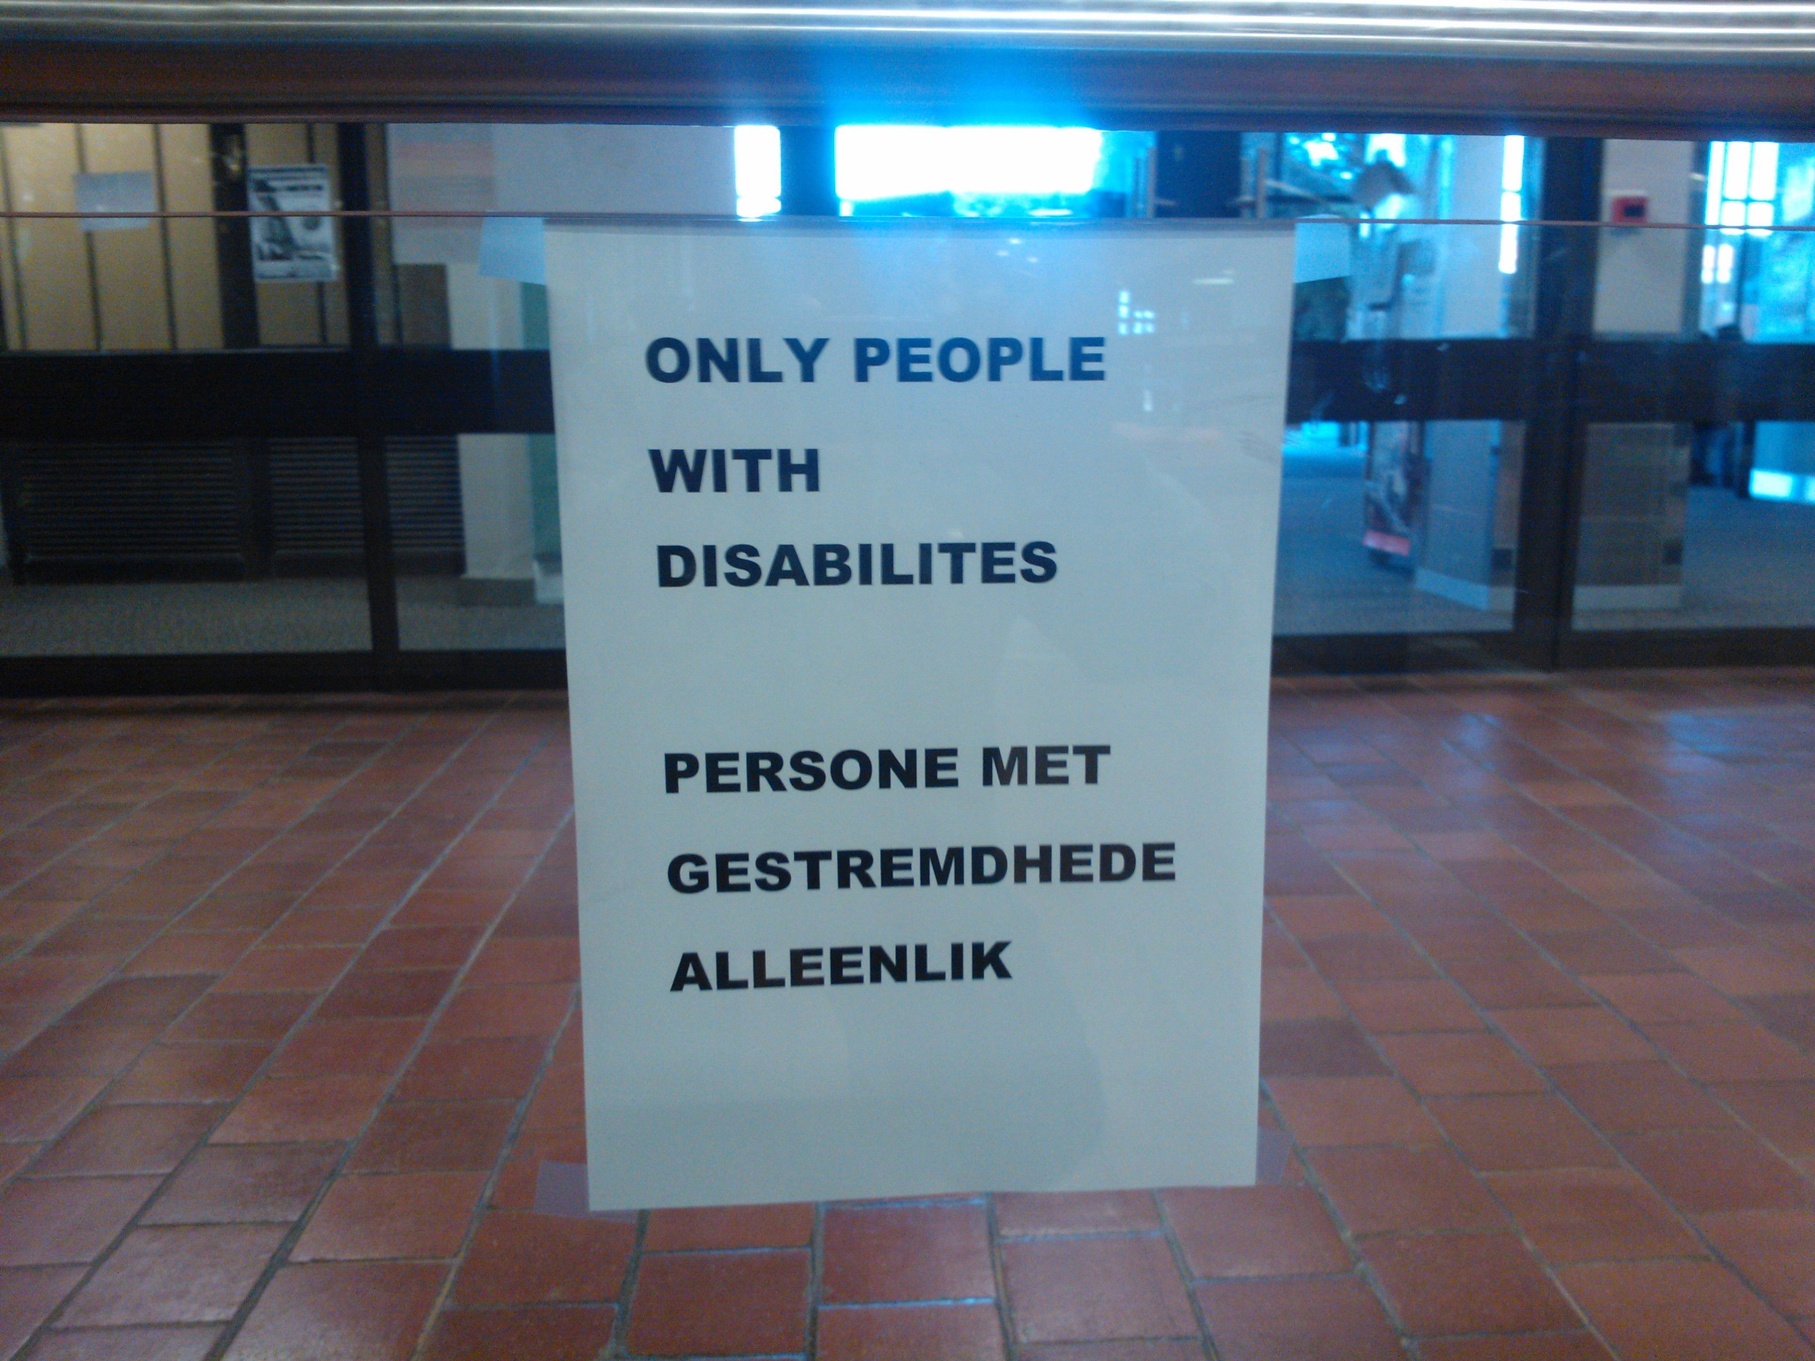
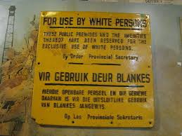
Social model??

Slide 10
DISCUSSION
Social Models-social structures (UK) & social roles (US)
Medicalisation-medical interventions
  Interactional & complexities of disability
Capabilities approach-human beings are are not the same (capabilities & limitations) [agency & conversion factors]
  Context matters in analysing people’s situations
      History
      Language
      Culture
Critical realism perspective

Slide 11
CONCLUSION
Disability =complex
The current South African disability paradigm disadvantage disabled students
  The model being followed
  The ways in which the model is being applied/ not being applied
Expansive complicated theories
  Critical Realism Perspective
    Capabilities Approach

Slide 13
SELECTED REFERENCES
Barnes, C. (2012) The Social Model of Disability: Valuable or Irrelevant? In Watson, N. Roulstone, A. and Thomas, C. The Routledge Handbook of Disability Studies. London: Routledge.
Finkelstein, V (2001) A personal journey into disability politics. Available online at www.indepenentliving.org
Howell, C. (2005) South African Higher Education Responses to Students with Disabilities. Pretoria: Council on Higher Education
Hughes, B and Paterson, K (1997) The Social Model of Disability and the Disappearing Body: towards a sociology of impairment. Disability and Society. 12(3): 325-340.
Matshedisho, K. R. (2007) Experiences of disabled students in South Africa: Extending the thinking behind disability support, South African Journal of Higher Education. 24(5): 730-744.
Mitra, S. Reconciling the Capability Approach and the ICF: A Response. ALTER: European Journal of Disability Research, Forthcoming.
Oliver, M. (1996) Understanding disability. New York: St Martin’s Press.
Shakespeare, T (2014) Disability Rights and Wrongs Revisited. New York: Routledge.
Swartz, L and Watermeyer, B. (2008) Conceptualising the psycho-emotional aspects of disability and the distortion of personal and psychic boundaries. Disability and Society. 29(6): 599-610.
Thomas, C. 2004. How is disability understood? An examination of sociological approaches. Disability and Society. 19(6):569-583.

